Slide 1

The Life of John
Geography, Communication and Spatial Mobility
Rachid Berghout

Slide 2
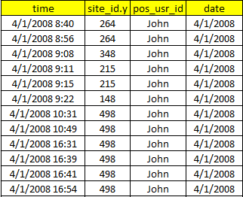
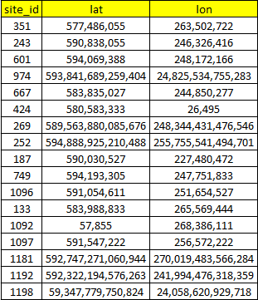
 | Total amount of days | Our data | Percentage of covered days
Total | 2557 | 2439 | 95.38%
Weekdays | 1827 | 1747 | 95.62%
Weekends | 730 | 692 | 94.79%

Slide 3
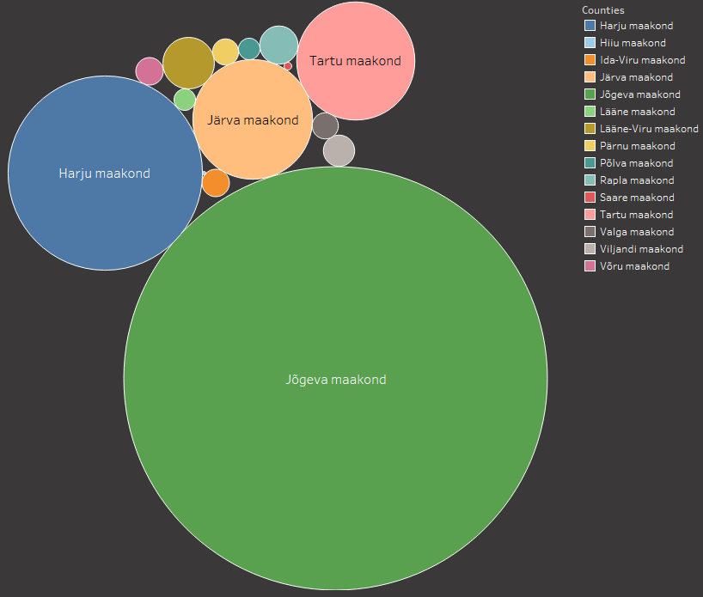
Calls abundance per counties
2 309
2370
6 252
29 693
Harju maakond
Jõgeva maakond
Tartu maakond
Järva maakond

Slide 4
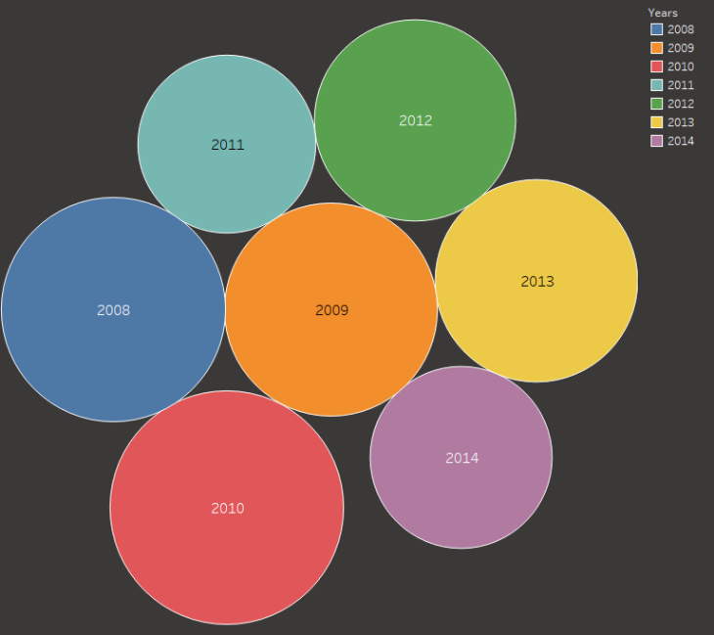
Calls abundance per years

Slide 8
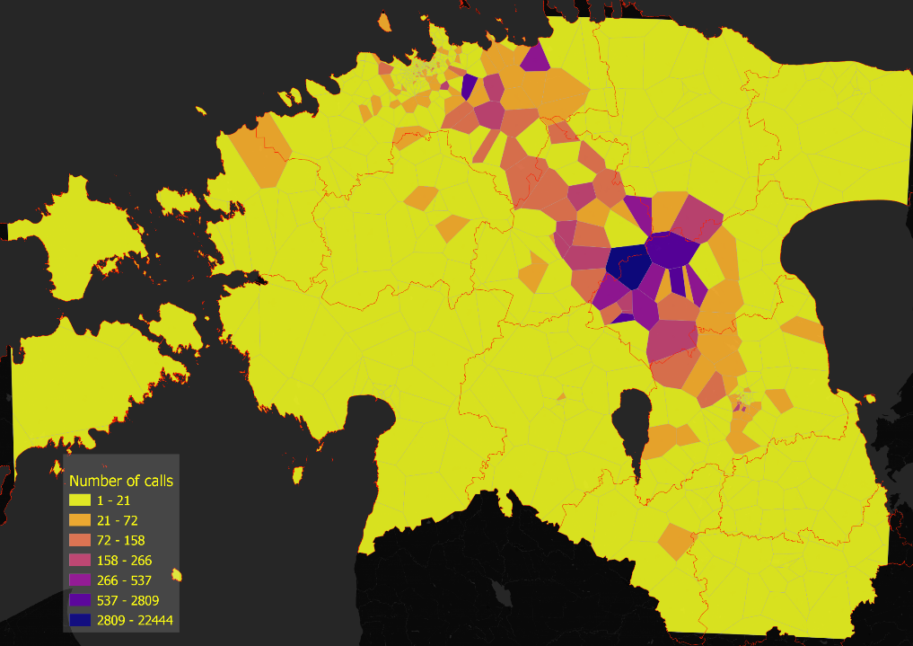

Slide 9
